Slide 1
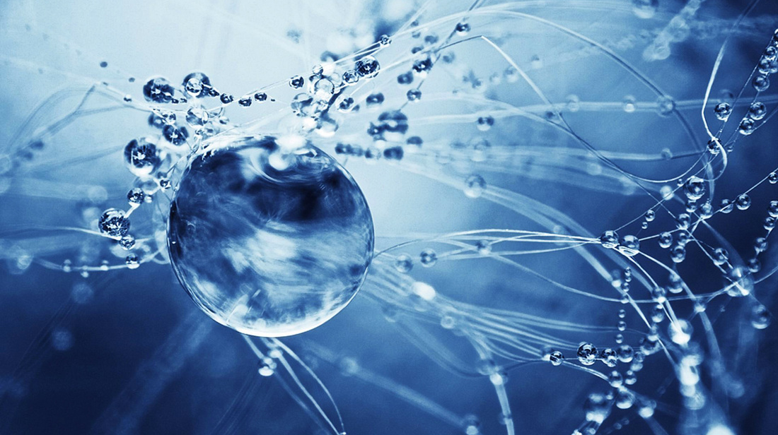
Water: the universal solvent

Slide 2
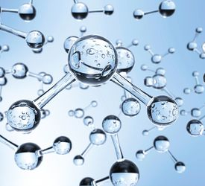
Outline
General interaction
Dissolving molecular substances
Dissolving ionic substances
Predicting solubility and colour using your data sheet

Slide 3
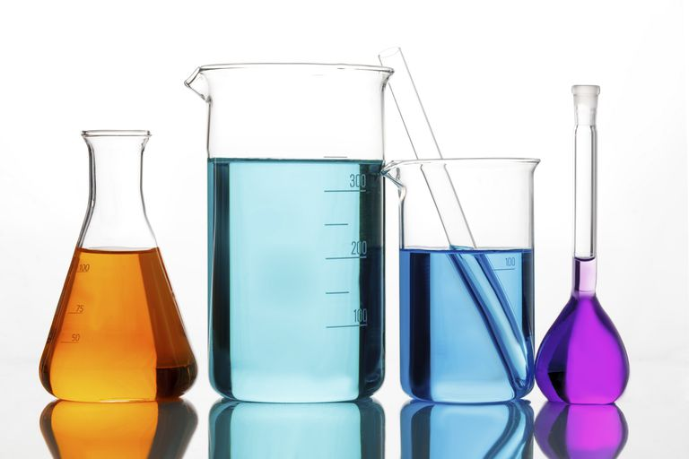
Solute and solvent
Aqueous solution – formed when a solid, liquid or gas dissolved in water
The substance that dissolved is the solute, the water is the solvent
Solutions are homogeneous (you cannot distinguish between solute and solvent particles) and the particles are too small to see (a clear liquid, no cloudiness at all)

Slide 4
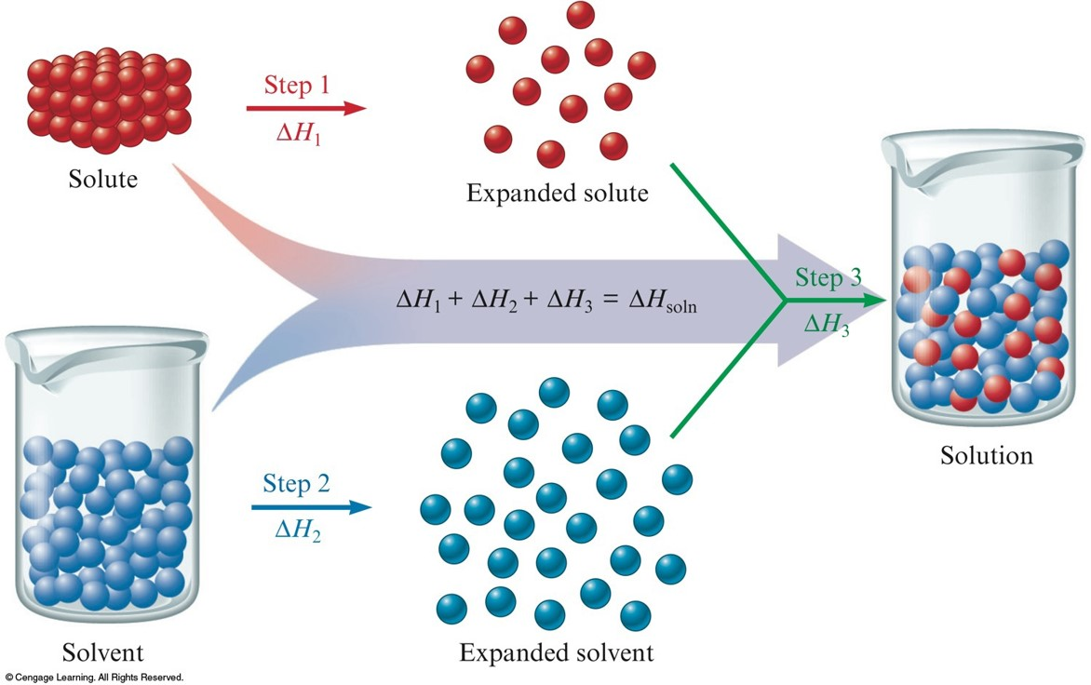
Dissolving process
Dissolution
Particles of the solvent are separated from one another
Particles of the solute are separated from one another
Solute and solvent particles are attracted to each other
To be soluble – solute-solvent interactions must be stronger than the solute-solute and solvent-solvent interactions

Slide 5
Solubility of molecular substances
Most, larger, molecular substances are not soluble or sparingly soluble in water (e.g. hexane is insoluble in water)
Some smaller molecules are soluble in water (e.g. sucrose, ammonia and hydrogen chloride). This occurs in two main ways:
Molecular compounds that form hydrogen bonds with water
Molecular compounds that ionise

Slide 6
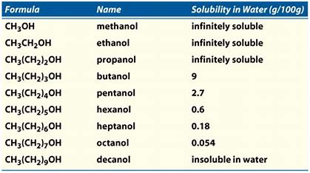
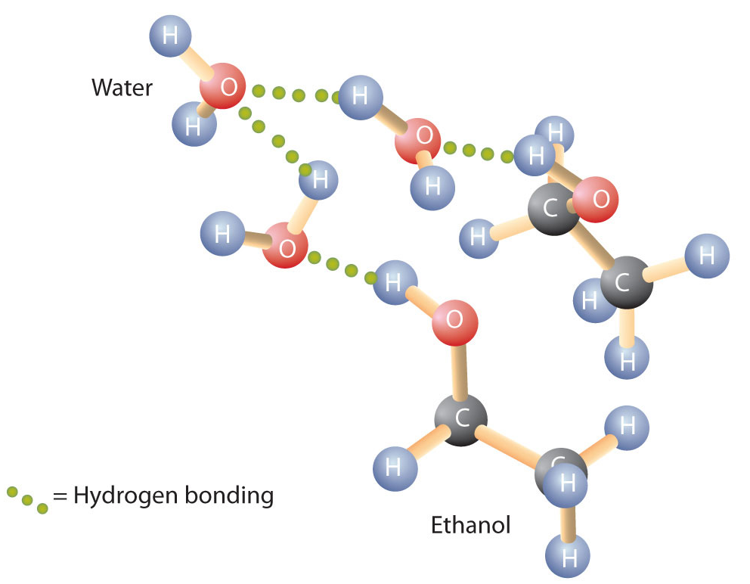
Dissolving molecular substance: H-bonding
Small molecular substances that can hydrogen bond with water tend to be soluble
Example 1 - alcohols
Methanol, ethanol and propanol are infinitely soluble (miscible)
As dispersion forces increase the solubility in water decreases

Slide 7
Dissolving molecular substance: H-bonding
When a substance dissolves in water we can write a solvation equation for the process
Note – water is written above the arrow as this is not a chemical reaction, just a physical mixing that is reversible
H₂0
C₂H₅OH_{(l)} C₂H₅OH_{(aq)}

Slide 8
Dissolving molecular substance: H-bonding
Sugars – such as glucose, sucrose, fructose. Sugars contain a number of polar –OH groups that can hydrogen bond to water.
Vitamins – some are water soluble and others are fat soluble. This has an affect on how they are stored in the body. Water soluble vitamins are excreted so you need to constantly replenish them. As others are stored in fat, the body can tolerate a shortage in food for a period of time but it can be dangerous if you consume too much of them (they build up)
Pharmaceuticals – as most need to travel through the blood, a lot of research goes in to making complex and sometimes large molecular substances more soluble in water

Slide 9
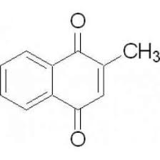

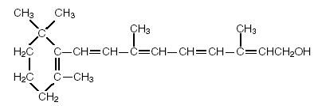
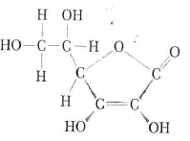
Dissolving molecular substance: H-bonding
Examine the structure of each vitamin and classify them as water soluble or fat soluble:
a) Vitamin B₅
b) Vitamin K₃
c) Vitamin A
d) Vitamin C

Slide 10

Dissolving molecular substance: Ionisation
Some molecules contain very strong polar bonds that break when they dissolve in water
Example: hydrogen chloride, HCl, is a gas at room temperature. The H-Cl bond is highly polar. When added to water the hydrogen atom forms a strong hydrogen bond to water while the chloride (which is very electronegative) attracts electrons so strongly that the H-Cl bond breaks. This ionisation form chloride ions (Cl⁻) and hydronium ions (H₃O⁺)

Slide 11
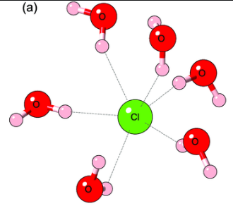
Dissolving molecular substance: Ionisation
Note – water is part of the equation
It is called ionisation as you go from a neutral covalent molecular compound and form charged ions
The state (aq) means the ions are hydrated (form ion-dipole attractions to water molecules)

Slide 12
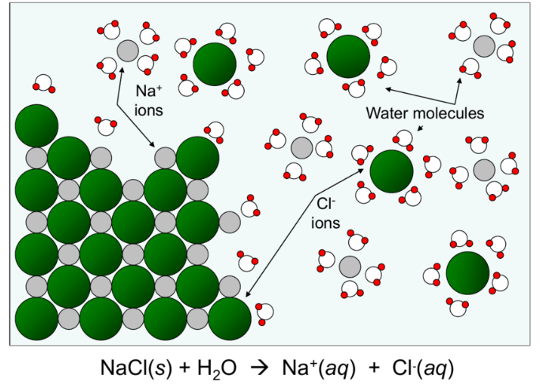
Solubility of ionic compounds: Soluble salts
The water is attracted through ion-dipole interactions to the surface of the ionic compound
If the attraction is strong enough the water will pull the ions away from the ionic lattice

Slide 13
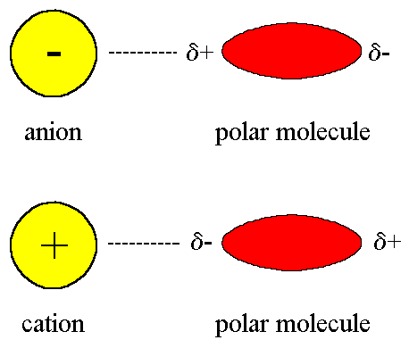
Solubility of ionic compounds: Soluble salts
The process for dissolving an ionic compound is called dissociation
Dissociation involves free existing ions from the ionic lattice
**Note the difference – ionisation involves forming ions from a molecule that was neutral, covalent**
Ion-dipole interactions
H₂0
NaCl_{(s)} Na⁺_{(aq)} + Cl⁻_{(aq)}
Above is a solvation equation for a dissociation process. Note the water is above the arrow.

Slide 14
Solubility of ionic compounds: Insoluble salts
If the attraction between the water and ions are not strong enough, the ion cannot be removed from the ionic lattice and the compound does not dissolve.
Solubility is a scale with ionic compounds ranging from highly soluble to slightly soluble to insoluble.

Slide 15
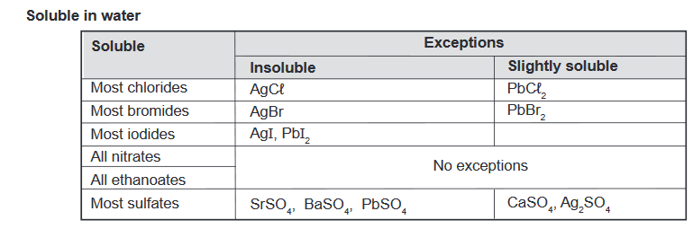
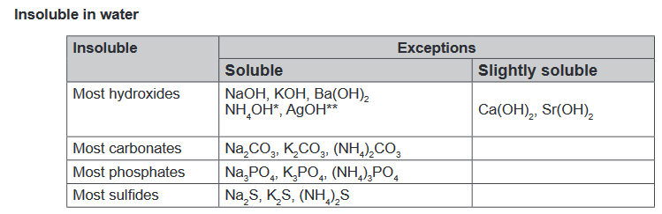
Using the Date Sheet to predict solubility and colour
Practice:
KI , Pb(NO₃)₂ , PbI₂, KNO₃
S
S
IS
S

Slide 16
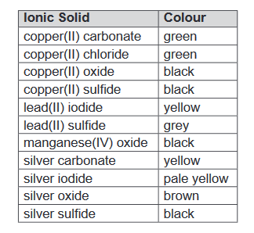
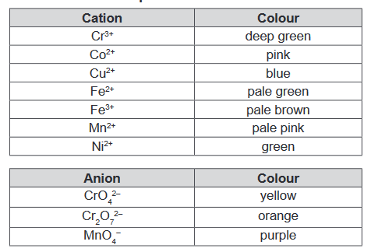
Using the Date Sheet to predict solubility and colour
In general, ionic solids have the same colour as that of any coloured ion they contain
Two colourless ions in general produce a white solid
Selected exceptions are in the Data Sheet

Slide 17
On going work
Complete Pearson 15.5 review questions, then work backwards and look at 15.1 to 15.4

